Slide 1
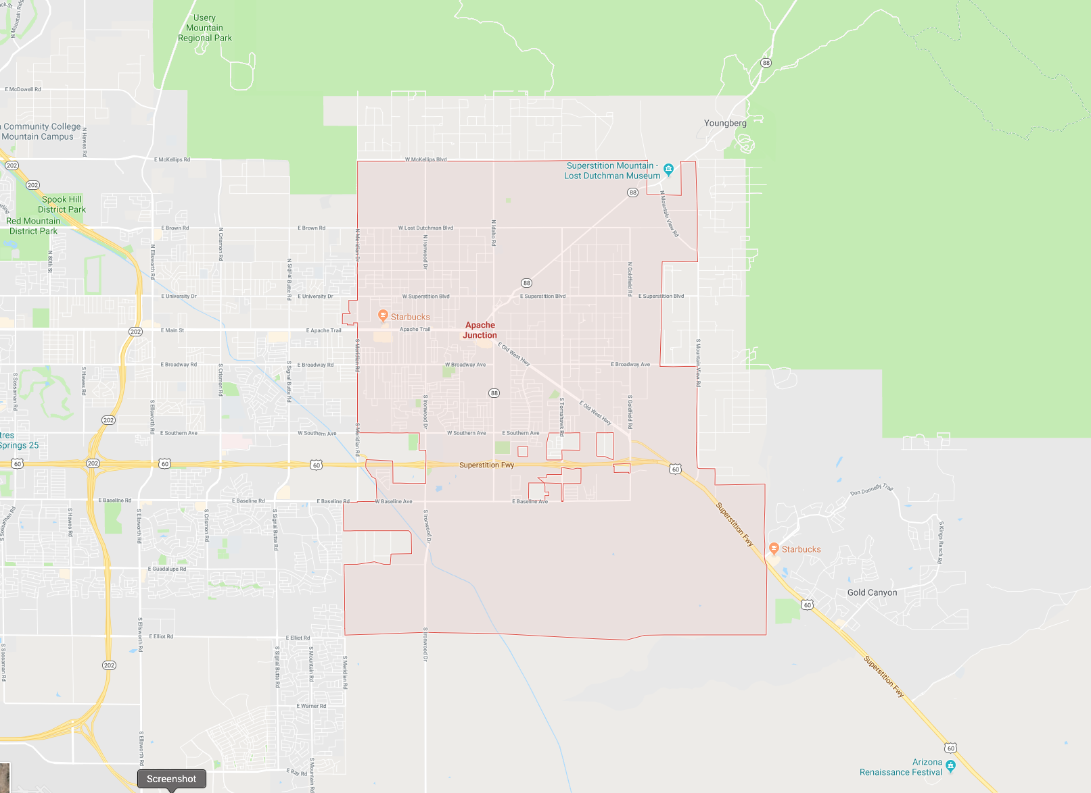
The Development of a Geographic Information System Data Model for the city of Apache Junction
John Bonifas
MS Applied Geospatial Sciences Candidate
Department of Geography, Planning, and Recreation
School of Social Behavioral Sciences
Northern Arizona University
February 14, 2019

Slide 2
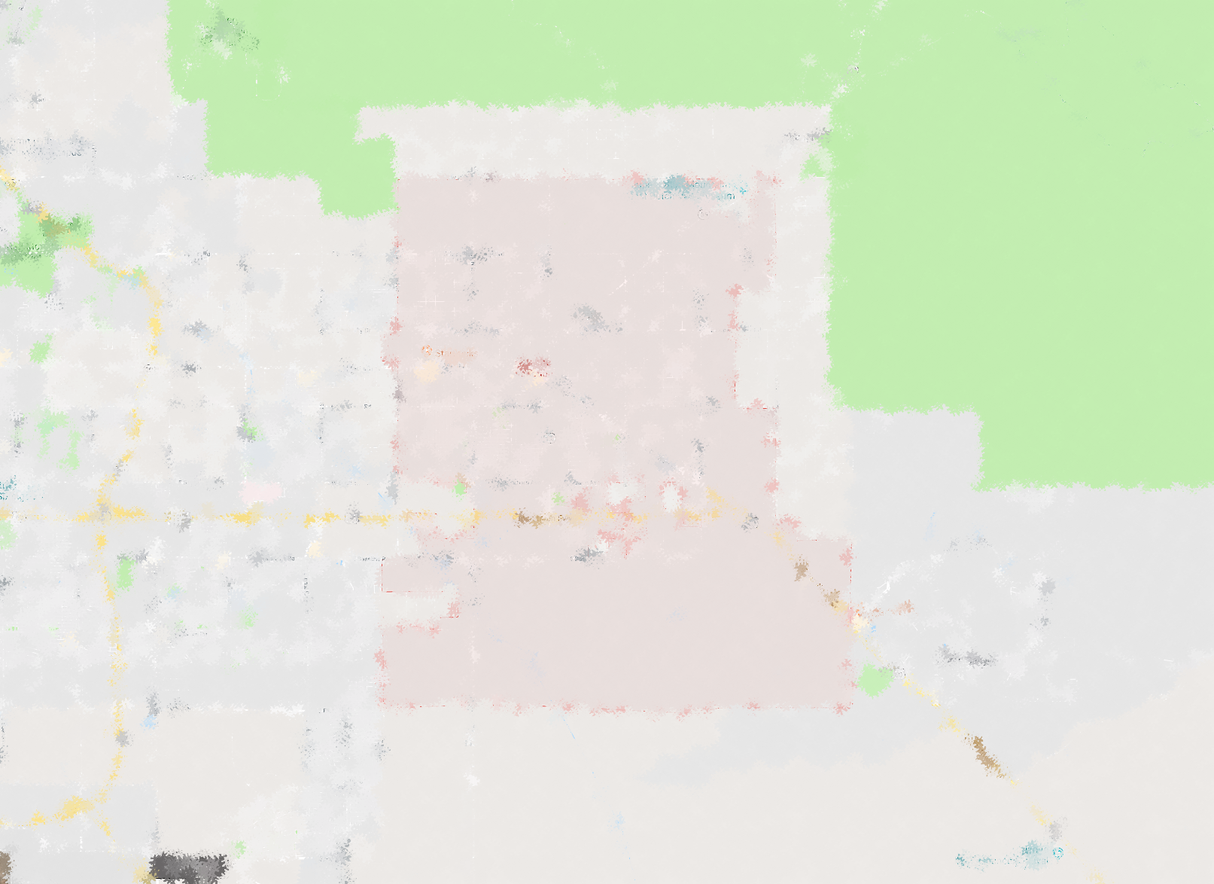
Advisor and Committee Members
Advisor and Committee Chair:
Dr. Ray Huang
Committee Members:
Dr. Erik Schiefer
J.C. Kliner

Slide 3
Objectives and Goals
Gather data requirements from city departments
Develop listing of city business functions
Develop conceptual data model from the business function listings
Develop logical data model from the conceptual data model

Slide 4
Geographic Information System Technology
A GIS is a computer system that contains and manipulates geographically referenced information, such as spatial data
An Enterprise GIS supports special features over and above a system not containing spatial data, such as relationships between spatial entities and entity versioning
A GIS supports non-spatial data and two kinds of spatial data: vector and raster

Slide 5
GIS Terminology - 2
A utility network in an enterprise GIS connects related spatial features together to enable the determination of flow and direction, such as the flow of water
A transportation network also connects features together, but to enable the determination of the shortest distance between two points
A topology is a set of rules that enable spatial entities to relate to each other. These relationships can support spatial data constraints, or spatial area containment
Domains are constraints on entity attributes in order to manage the values that those attributes can be assigned

Slide 6
Conceptual Data Model
Identifies the highest-level relationships between the different entities
Very abstract, no technical detail
End result: logical groupings of data

Slide 7
Logical Data Model
describes the data in as much detail as possible, without regard to how it will be physical implemented in the database
Technical detail: generic data types and entities

Slide 8
Problem Statement
City’s procedures old, outdated
City’s departments use their own, proprietary GIS software
GIS technology funding tightly constrained

Slide 9
Background
4/2016 – City Council approves hiring of GIS coordinator
5/2016 – GIS development approved; data entry begun
Summer 2017 – City Council approves writing of 5 yr GIS Plan
11/2017 – GIS coordinator authorizes GIS simulation ONLY – no access to city’s GIS systems or data, but can use the schema

Slide 10
The plan: simulate model without real data
The original plan was to create some simulated datasets to use when designing the data model
However, simulated data not needed because the implementation was not required

Slide 11
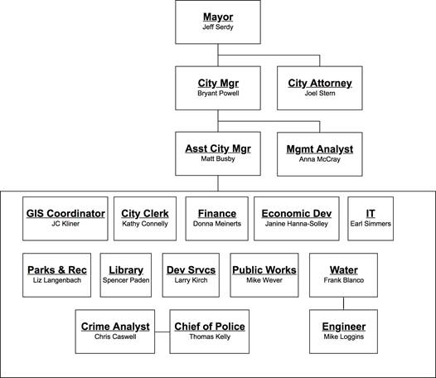
First Step: Gather business functions
Interview representatives of the various city departments
Take notes
Gather business functions from the notes

Slide 12
Second Step: Identify GIS Objects from Business Functions

Slide 13
Third Step: Create Logical Schema

Slide 14
Implementation Using Enterprise Architect
XML Document

Slide 15
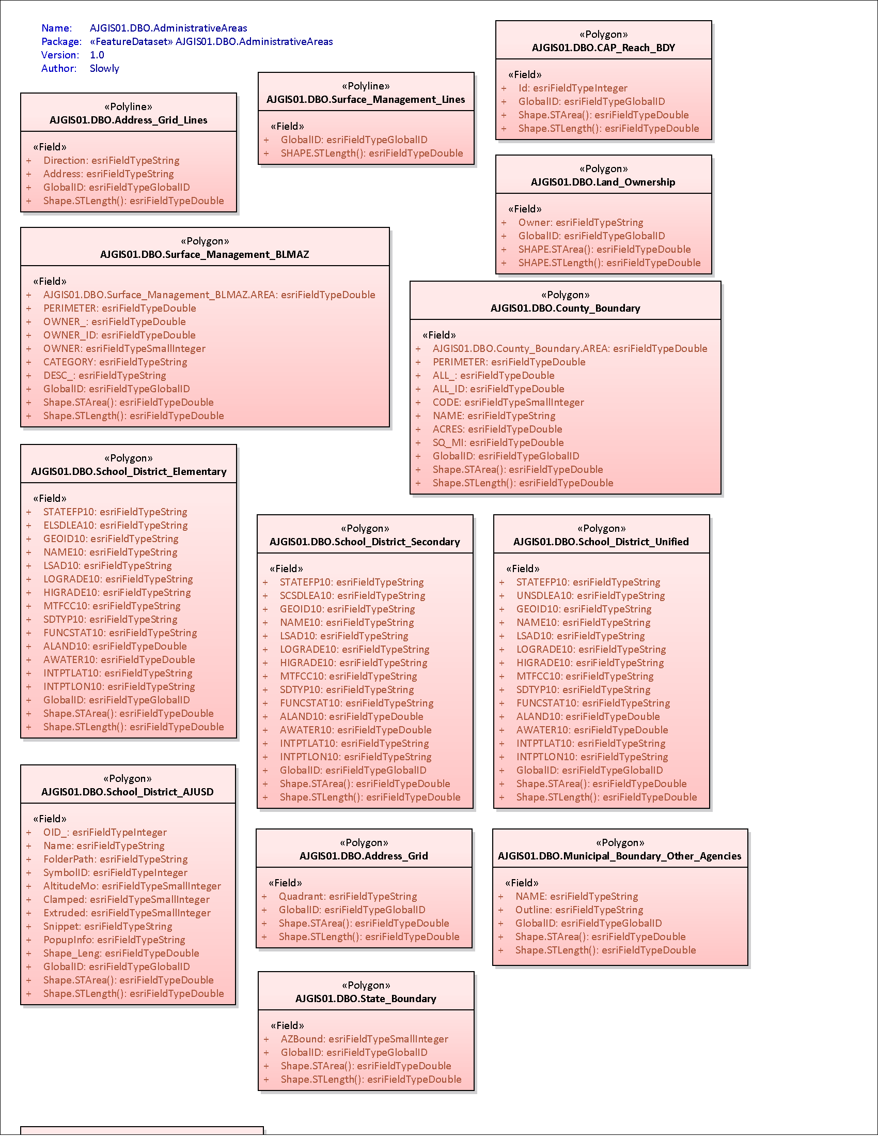
Results: Schema Before... and After
Duplicated objects and redundant attributes
Duplicate, redundant obects removed
Relationships and topologies added to enforce data integrity
Domains and subtypes added to enhance data accuracy
Network functionality built-in for future use

Slide 16
Highlights: Administrative Areas
Added containment topology, partly in support of unincorporated Pinal County ‘Holes’
Polygon featue – point feature – point feature relationships

Slide 17
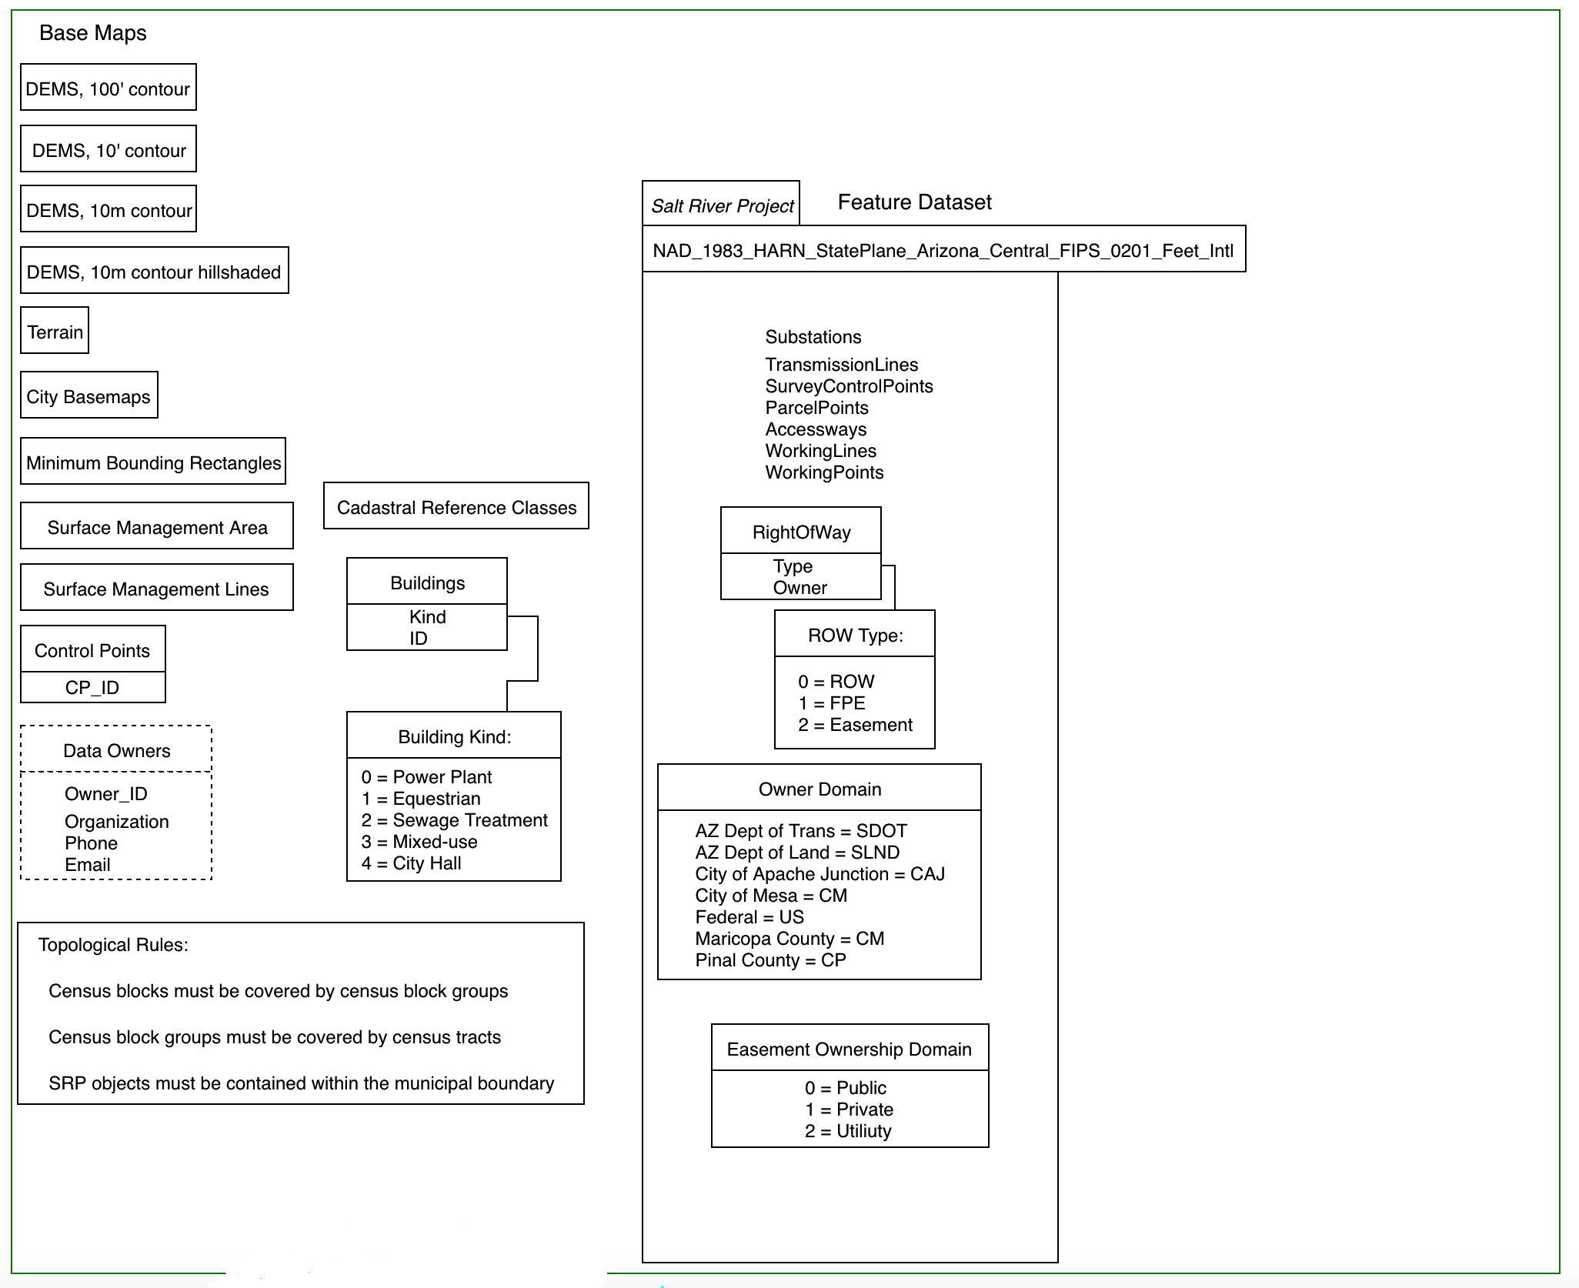
Highlights: Base Maps
Most reference objects, used only by the GIS Coordination team, moved here
External objects from Salt River Project placed in their own feature dataset
Data Owners table added for support of data accountability and audit trails

Slide 18
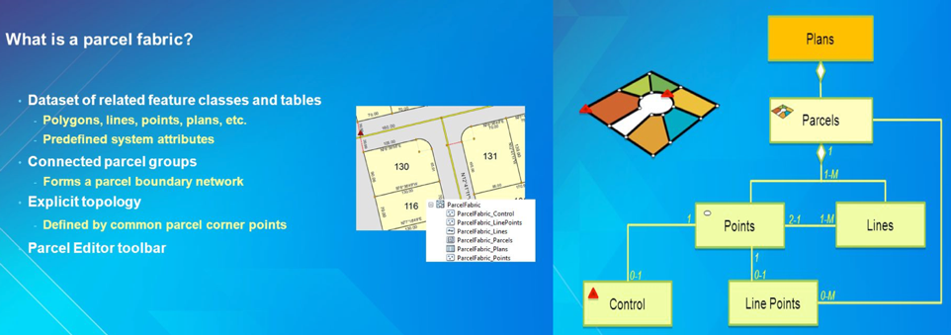
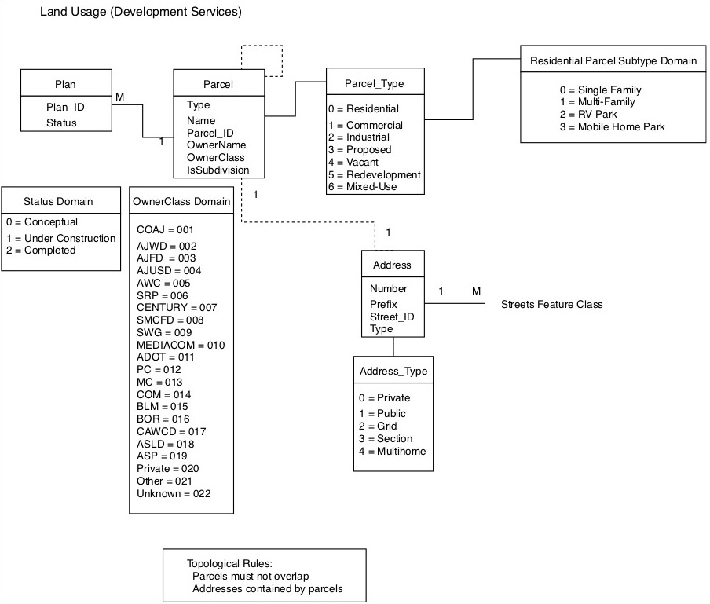
Highlights: Land Usage (Parcel Fabric)
Standardized, integrated
PE Toolbar
Parcel Workflows
Tax parcels
Plan directory
History support

Slide 19
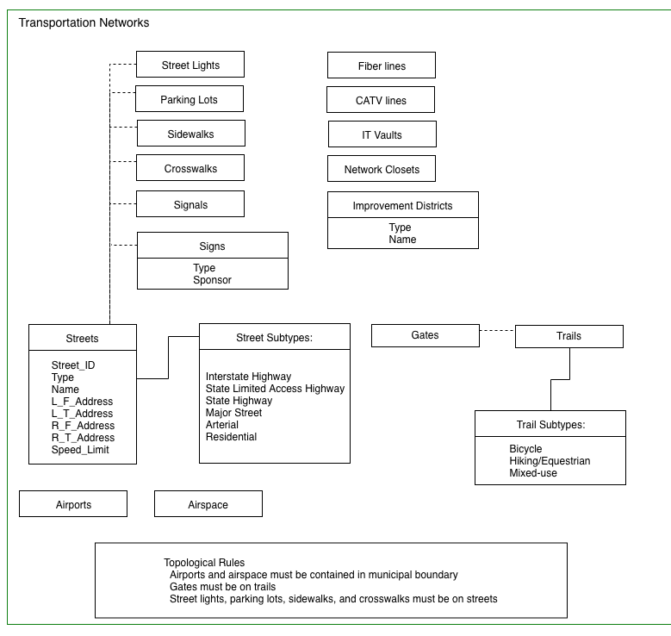
Highlights: Transportation (Network)
Transportation feature dataset has companion: Transportation Networks
In the future, this feature dataset and its companion will enable shortest-distance-between-two-points analysis

Slide 20
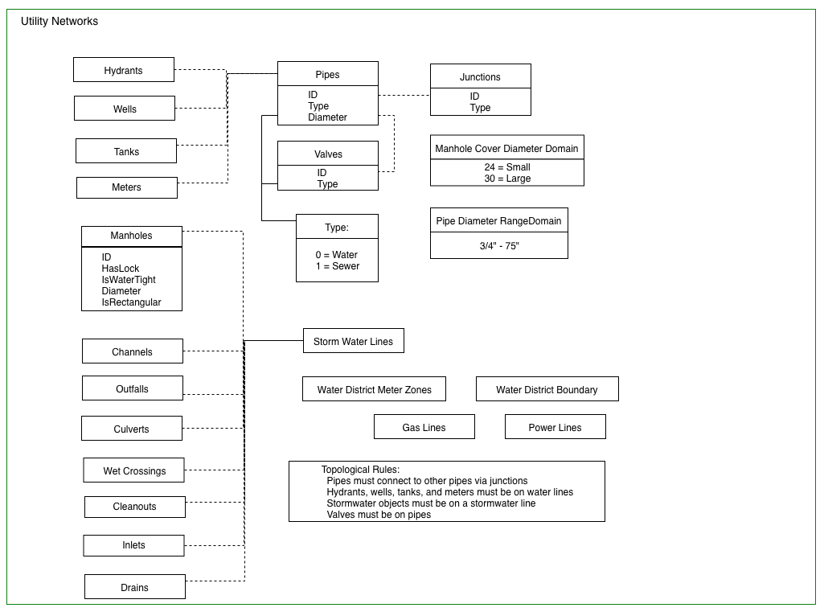
Highlights: Utility (Network)
Utilities feature dataset has companion: Utility Networks
In the future, this feature dataset and its companion, which supports geometric networks, will enable directional commoddity flow analysis

Slide 21
Question and Answer Period
?

